Slide 1


NLP – Natural Language Processing

Slide 2
NLP – Natural Language Processing
I. Machine learning in Natural Language Processing
II. Word2Vec
III. Transformers

Slide 3
NLP – Natural Language Processing
I. Machine learning in Natural Language Processing
II. Word2Vec
III. Transformers

Slide 4



Part 1 Machine learning in Natural Language Processing

Slide 5

Several Options
Bag of words with randomally numbers
1 3 8 7 2 4 15 10 0 789 92 34 47 71 79
Tf – idf

Slide 6
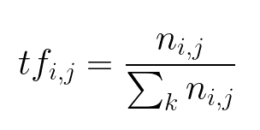
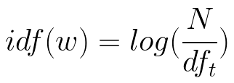
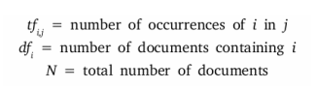
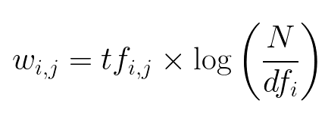
Explaination
the ratio of number of times the word appears in a document compared to the total number of words in that document

Slide 7
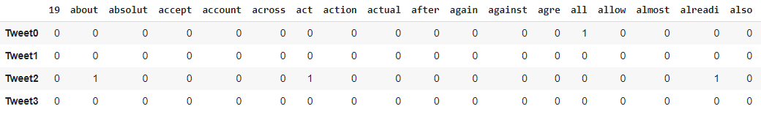
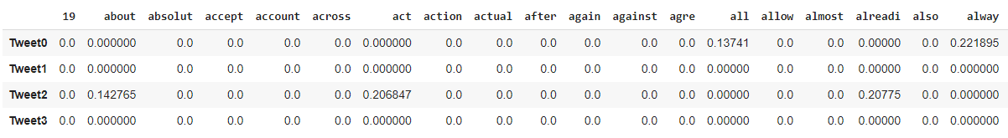
TF-IDF
1 2 3 4 5 6 7 8 9 10 11 12 13 14 15 16
Frequency
TF-IDF
1 2 3 4 5 6 7 8 9 10 11 12 13 14 15 16

Slide 8


Slide 9
NLP Problem : How to rate a review

Slide 10
Machine Learning
Two Algorithm :
Naive Bayse
Decision tree

Slide 11






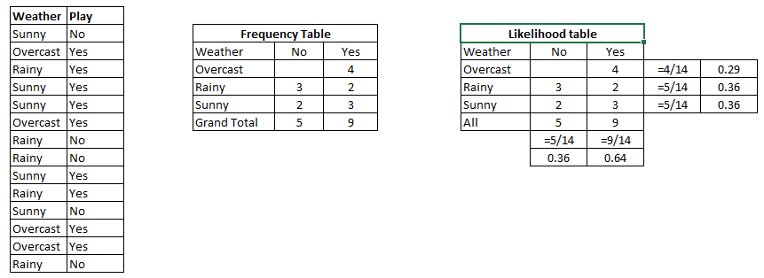
Naive bayse

Slide 12
Naive bayse (example from NLP)
Rate reviews :
- it’s beautiful !
1
5
4
5

Slide 13
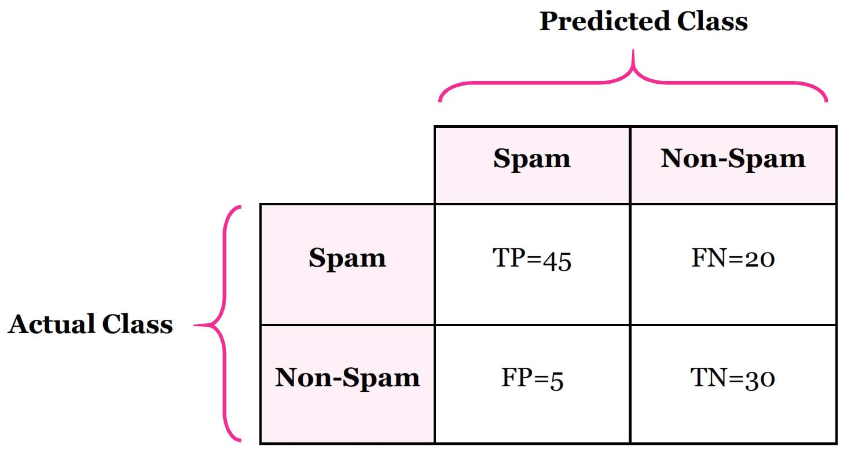
Reminder - Confusion Matrix
- Accuracy
Positive
Negative
Accuracy = (TP + TN )/ (TP + FN + FP + TN)

Slide 14
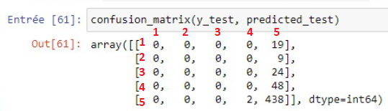
Reminder – Accuracy (suite)

Slide 15
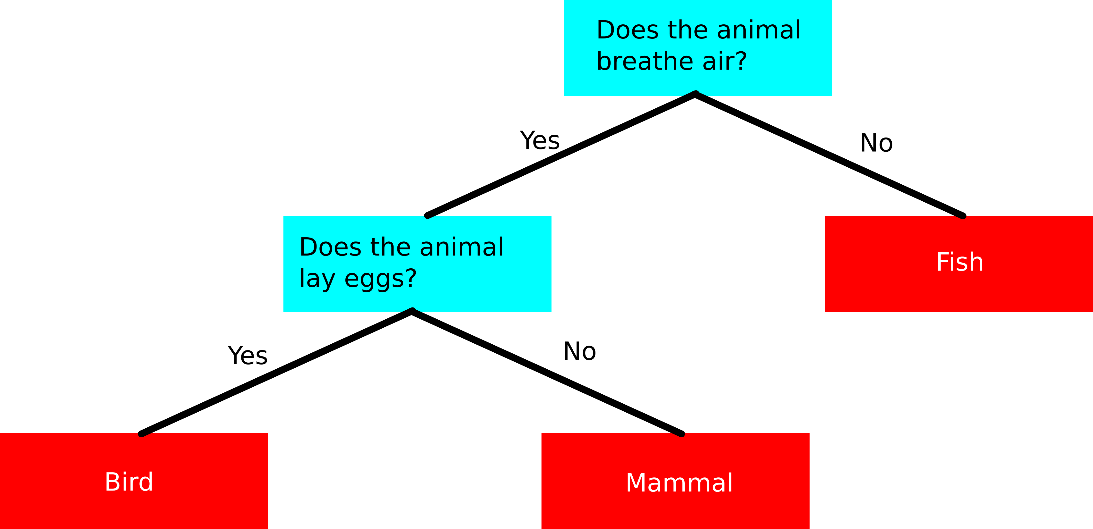
Decision tree
overcast
Rainy
sunny
Yes
No
Not play
play
Not play
play

Slide 16
NLP – Natural Language Processing
I. Machine learning in Natural Language Processing
II. Word2Vec
III. Transformers

Slide 17
NLP – Natural Language Processing
Bag-of-words
Word2Vec
I. The Goal
II. Implementation
Reminder :
Linear Regression
Cost Function
Neural Network
Entrainment of the Network
Skip-Gram (SG) / Continuous Bag Of Word (CBOW)

Slide 18
NLP – Natural Language Processing
Bag-of-words
Word2Vec
I. The Goal
II. Implementation
Reminder :
Linear Regression
Cost Function
Neural Network
Entrainment of the Network
Skip-Gram (SG) / Continuous Bag Of Word (CBOW)

Slide 19
Bag Of Word
Example:
1) The blue car have two red doors
2) On the blue doors, there are poster of red car
Vocabulary : ( 12 words)
[“the“, “blue“, “car“ , “have“, “two“, “red“, “doors“ , “on“ , “there“, “are“, “poster“, “of“ ]
One Hot Encoding :
“the“ => [1,0,0,0,0,0,0,0,0,0,0,0] , “blue“=> [0,1,0,0,0,0,0,0,0,0,0,0]
…
“two“=> [0,0,0,0,1,0,0,0,0,0,0,0] , “red“=> [0,0,0,0,0,1,0,0,0,0,0,0] ,
…
“poster“=> [0,0,0,0,0,0,0,0,0,0,1,0] , “of“=> [0,0,0,0,0,0,0,0,0,0,0,1]

Slide 20
Bag Of Word
Vocabulary : ( 12 words)
[“the“, “blue“, “car“ , “have“, “two“, “red“, “doors“ , “on“ , “there“, “are“, “poster“, “of“ ]
1) The blue car have two red doors => [1,1,1,1,1,1,1,0,0,0,0,0]
2) On the blue doors,
there are poster of red car => [1,1,1,0,0,1,1,1,1,1,1,1]

Slide 21
Bag Of Word
[1,1,1,1,1,1,1,0,0,0,0,0]
[1,1,1,0,0,1,1,1,1,1,1,1]

Slide 22
Bag Of Word
Weaknesses:
word order : “John likes Mary” ~= “Mary likes John”
(issue : n-grams ?)
meaning of the underlying words : ‘’King’’ != ‘’Queen’’

Slide 23
NLP – Natural Language Processing
Bag-of-words
Word2Vec
I. The Goal
II. Implementation
Reminder :
Linear Regression
Cost Function
Neural Network
Entrainment of the Network
Skip-Gram (SG) / Continuous Bag Of Word (CBOW)

Slide 24
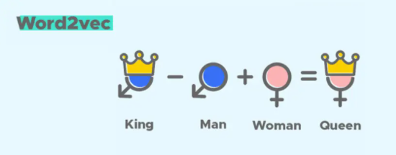
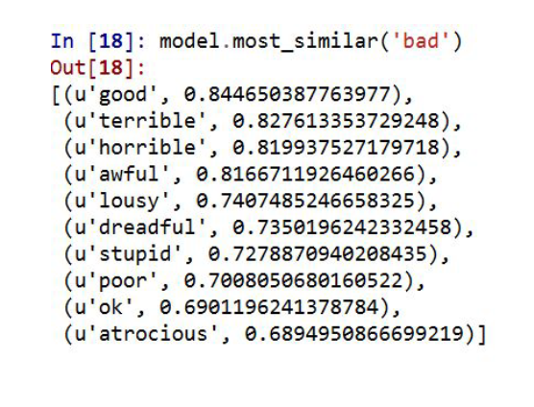
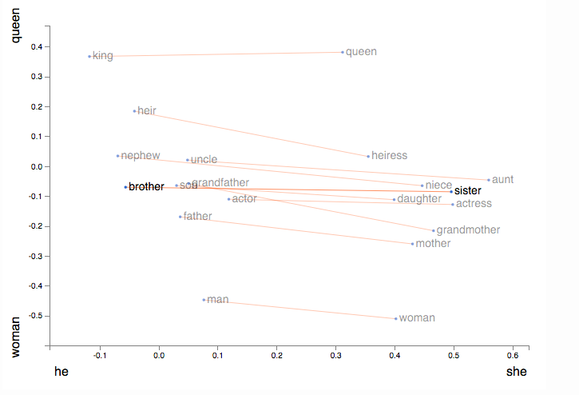
Word2Vec (Word To Vector)- The Goal
Similarity

Slide 25
Word2Vec (Word To Vector)- The Goal
BOW (bag of word)
Apple [ 1 , 0 , 0 ]
Mango [ 0 , 1 , 0 ]
Elephant [ 0 , 0 , 1 ]
Is_fruit is_animal is_eatable
Apple [ 0.9 , 0.01 , 1 ]
Mango [ 0.85 , 0.02 , 1 ]
Elephant [ 0.1 , 0.9 , 1 ]

Slide 26
NLP – Natural Language Processing
Bag-of-words
Word2Vec
I. The Goal
II. Implementation
Reminder :
Linear Regression
Cost Function
Neural Network
Entrainment of the Network
Skip-Gram (SG) / Continuous Bag Of Word (CBOW)

Slide 27
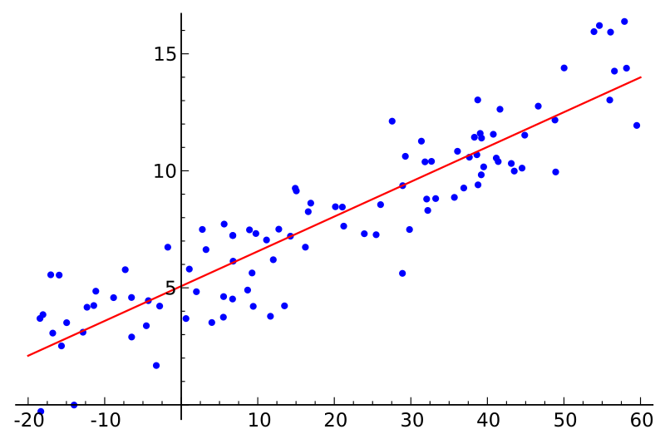
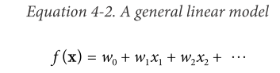
Linear Regression
Y
X
Independent
Variable
Dependent
Linear Model:
Slope
Intercept (bias)

Slide 28
NLP – Natural Language Processing
Bag-of-words
Word2Vec
I. The Goal
II. Implementation
Reminder :
Linear Regression
Cost Function
Neural Network
Entrainment of the Network
Skip-Gram (SG) / Continuous Bag Of Word (CBOW)

Slide 29
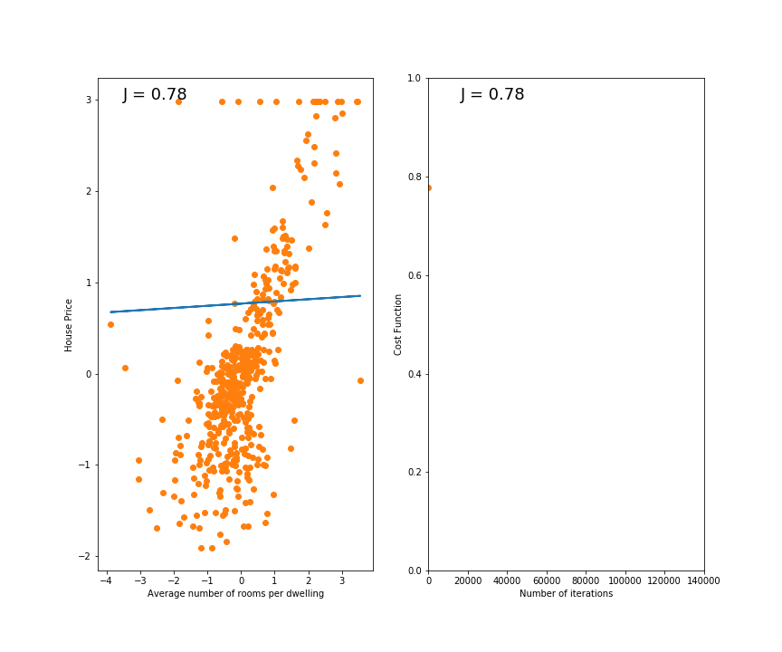
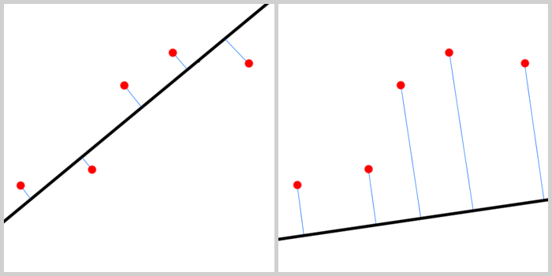
Error Function
Y
X

Slide 30
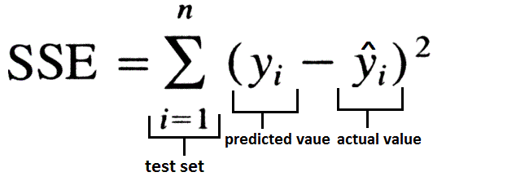
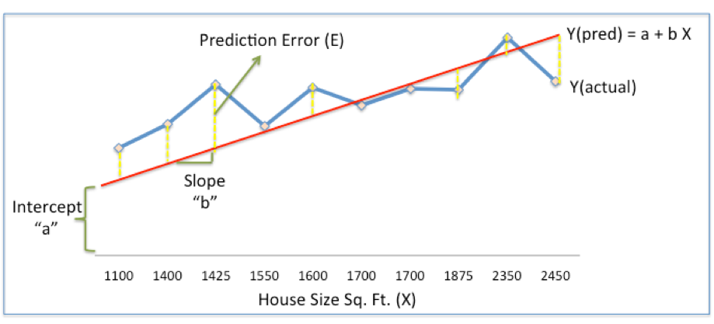
Error Function-- SSE
Sum of Squared Errors (SSE) = ½ Sum (Actual House Price – Predicted House Price)²
= ½ Sum(Y – Ypred)²

Slide 31
NLP – Natural Language Processing
Bag-of-words
Word2Vec
I. The Goal
II. Implementation
Reminder :
Linear Regression
Cost Function
Neural Network
Entrainment of the Network
Skip-Gram (SG) / Continuous Bag Of Word (CBOW)

Slide 32
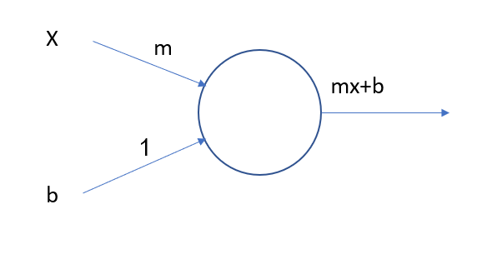
Neural Network
Y
X

Slide 33
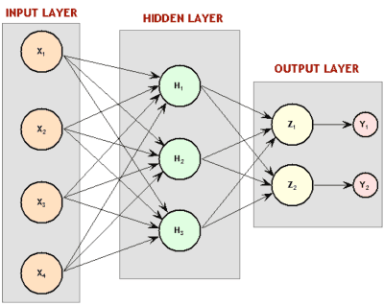
פתרון: רשת נוירונים Neural network
היה לנו נוירון בודד וקלט
נוסיף עוד נוירון (או יותר) לשכבת הפלט
נוסיף שכבת ביניים אחת (לפחות)
קיבלנו רשת נוירונים
ברשת הזאת כל הנוירונים מחוברים זה לזה (נראה אח"כ מבנים אחרים)

Slide 34
NLP – Natural Language Processing
Bag-of-words
Word2Vec
I. The Goal
II. Implementation
Reminder :
Linear Regression
Cost Function
Neural Network
Entrainment of the Network
Skip-Gram (SG) / Continuous Bag Of Word (CBOW)

Slide 35
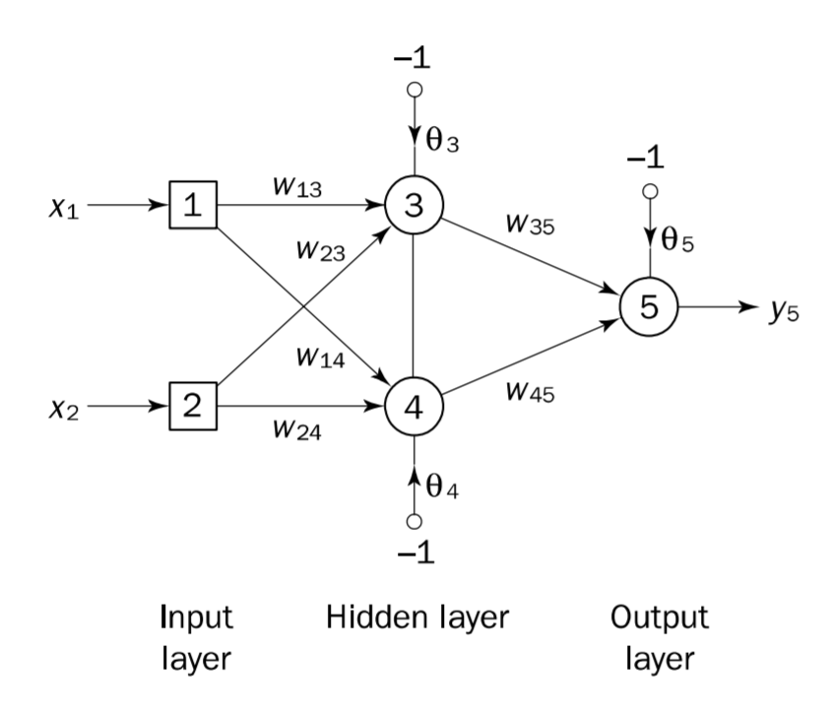
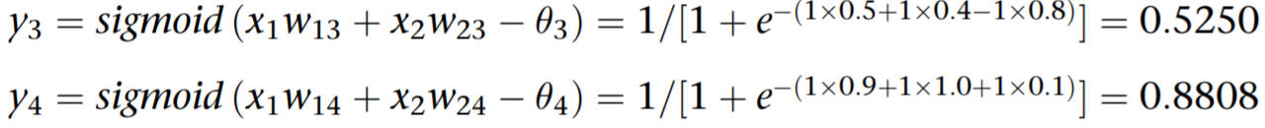
Forward Propagation
https://www.youtube.com/watch?v=lGLto9Xd7bU

Slide 36
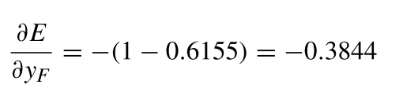
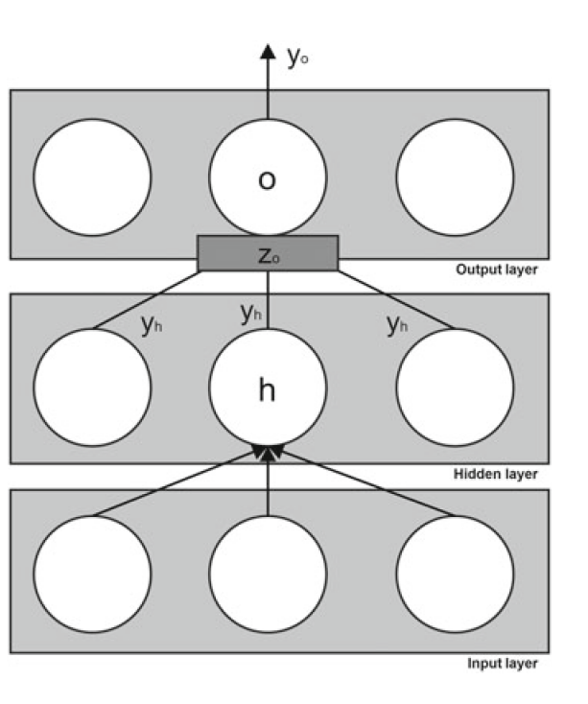
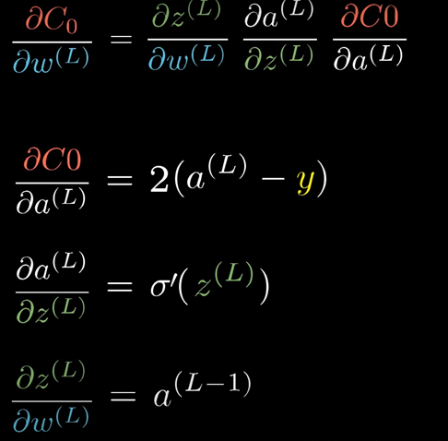
Backpropagation
https://www.youtube.com/watch?v=GJXKOrqZauk

Slide 37
NLP – Natural Language Processing
Bag-of-words
Word2Vec
I. The Goal
II. Implementation
Reminder :
Linear Regression
Cost Function
Neural Network
Entrainment of the Network
Continuous Bag Of Word (CBOW) / Skip-Gram (SG)

Slide 38
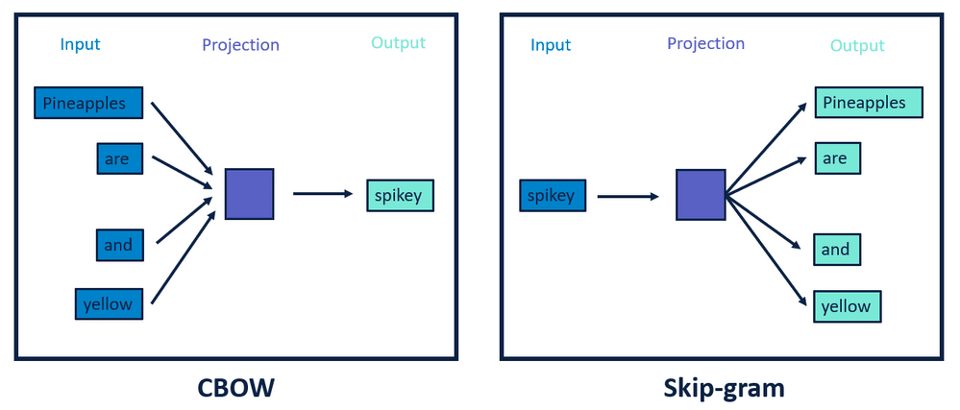
Continuous Bag Of Word (CBOW) / Skip-Gram (SG)

Slide 39
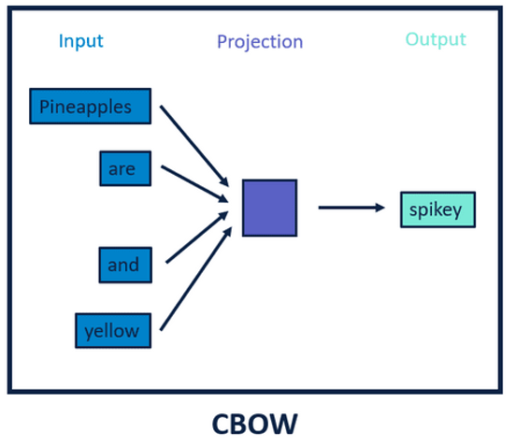
Continuous Bag Of Word
Pineapples are spikey and yellow
Context Target
BIG Data

Slide 40
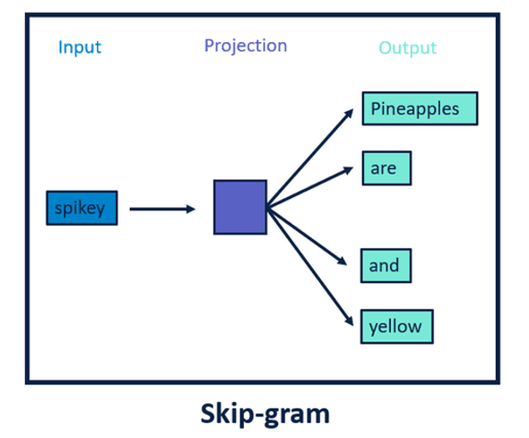
Skip-Gram (SG)
Pineapples are spikey and yellow
Context Target
SMALL Data

Slide 41
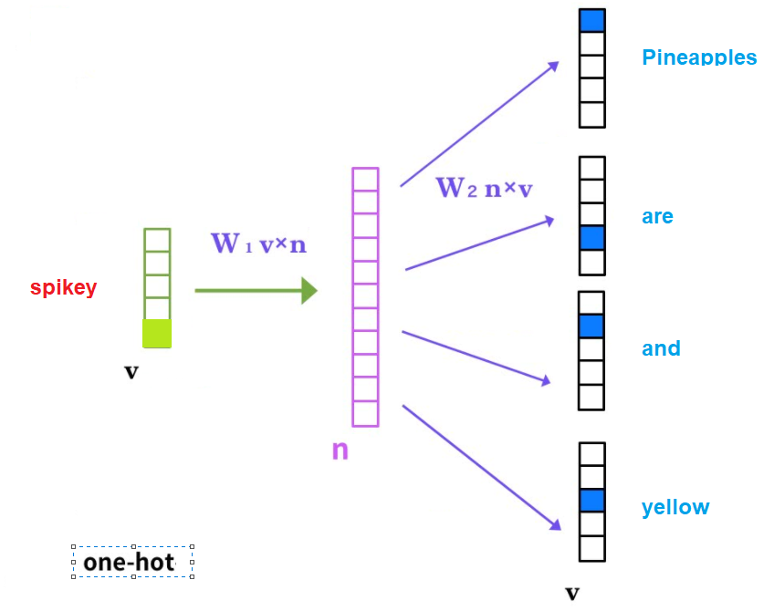
Skip-Gram (SG)
Input : Target Output: Context
Pineapples are spikey and yellow
Context Target

Slide 42
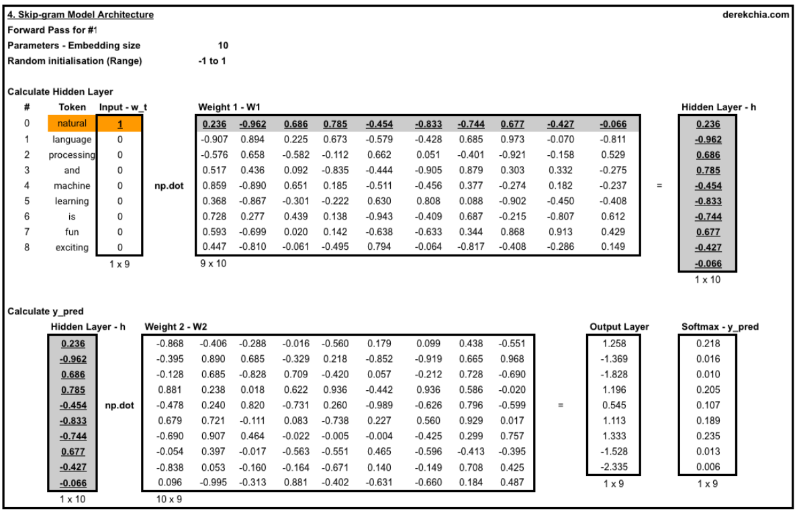
Skip-Gram (SG)
Similarity
Example:
Natural language processing and machine is fun exciting
Is_fruit is_animal is_eatable
Apple [ 0.9 , 0.01 , 1 ]
Mango [ 0.85 , 0.02 , 1 ]
Elephant [ 0.1 , 0.9 , 1 ]

Slide 43
NLP – Natural Language Processing
I. Machine learning in Natural Language Processing
II. Word2Vec
III. Transformers

Slide 44
Part 3
Transformer

Slide 45
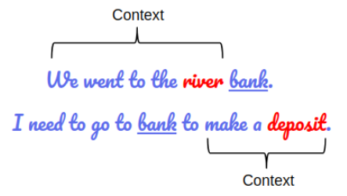
More efficient of Word2vec is it possible ?

Slide 46
Embeddings that allows us to have multiple (more than one) vector (numeric) representations for the same word
Word2Vec embeddings do not take into account the word position.
Transformers model explicitly takes as input the position (index) of each word in the sentence
Example: “John likes Mary” ~= “Mary likes John”

Slide 47
Transformers
Transformers structure
The encoder:
Input Embedding
Positional Encoding
Multi-Head Attention
Add & Norm
Feed Forward
The Decoder

Slide 48
Transformers
Transformers structure
The encoder:
Input Embedding
Positional Encoding
Multi-Head Attention
Add & Norm
Feed Forward
The Decoder

Slide 49
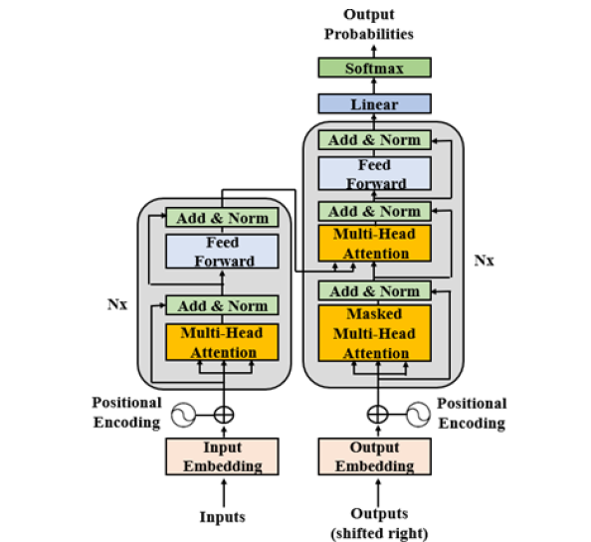
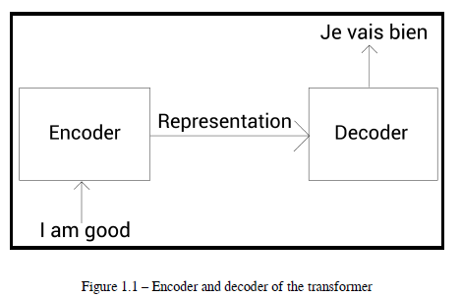
Transformers structure
Encoder

Slide 50
Transformers
Transformers structure
The encoder:
Input Embedding
Positional Encoding
Multi-Head Attention
Add & Norm
Feed Forward
The Decoder

Slide 51
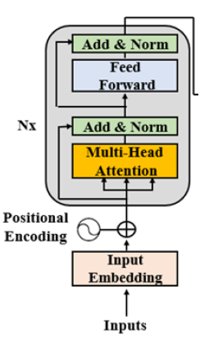
The encoder

Slide 52
Transformers
Transformers structure
The encoder:
Input Embedding
Positional Encoding
Multi-Head Attention
Add & Norm
Feed Forward
The Decoder

Slide 53
Step 1 :
Input Embedding

Slide 54
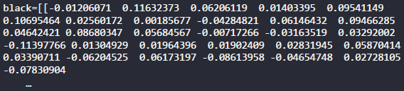
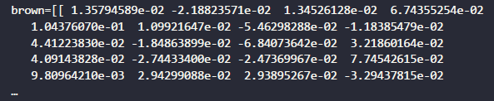
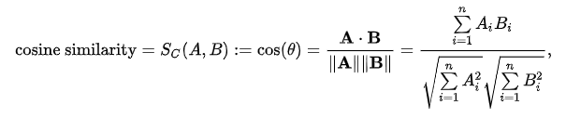

Slide 55
Transformers
Transformers structure
The encoder:
Input Embedding
Positional Encoding
Multi-Head Attention
Add & Norm
Feed Forward
The Decoder

Slide 56
Step 2 : Positional Encoding

Slide 57
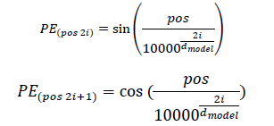
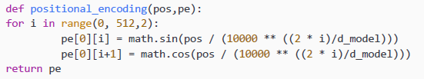
For the positional encoding (PE) for each position and each dimension i of the dmodel = 512 of the word embedding vector:

Slide 58
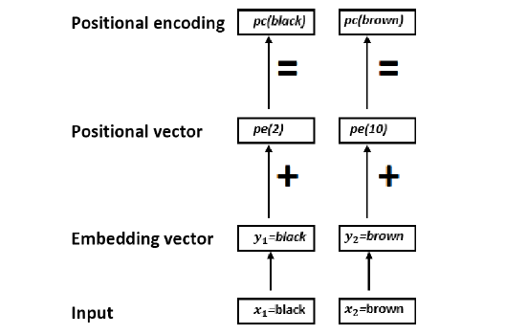

Slide 59
Transformers
Transformers structure
The encoder:
Input Embedding
Positional Encoding
Multi-Head Attention
Add & Norm
Feed Forward
The Decoder

Slide 60
Step 3 : Multi-Head Attention

Slide 61
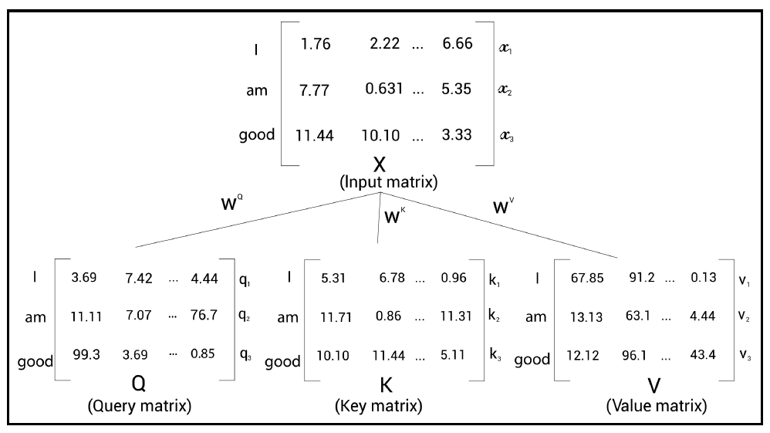
3 Random Matrix that we will calculate optimal values in the computing

Slide 62
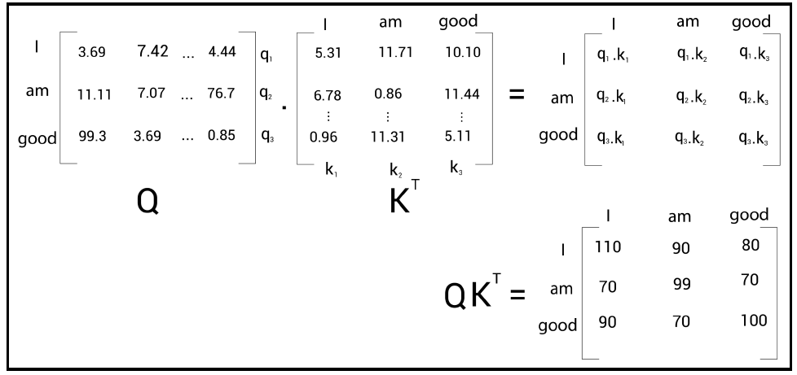

Slide 63
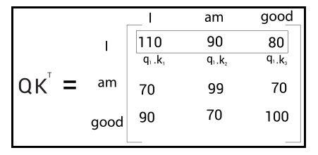
Related to itself more that he others

Slide 64
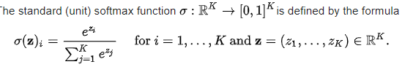
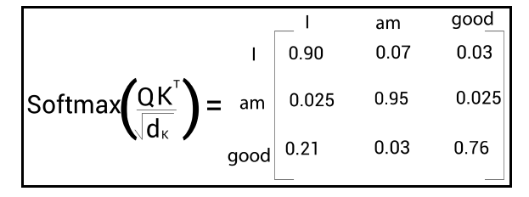

Slide 65
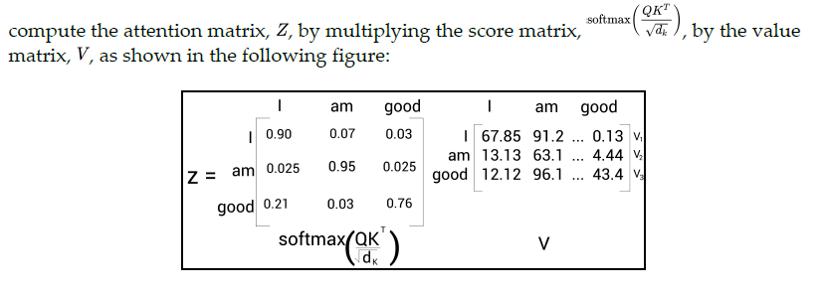

Slide 66
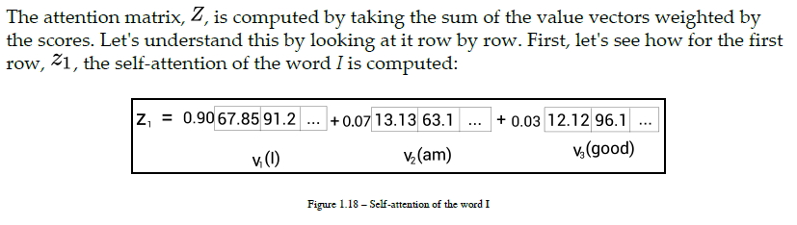
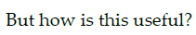
Attention Matrix

Slide 67
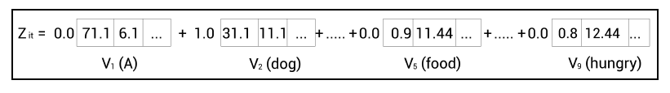
Come Back
Food ?
Dog ?

Slide 68
Transformers
Transformers structure
The encoder:
Input Embedding
Positional Encoding
Multi-Head Attention
Add & Norm
Feed Forward
The Decoder

Slide 69

Step 4 : Add & Norm

Slide 70
Transformers
Transformers structure
The encoder:
Input Embedding
Positional Encoding
Multi-Head Attention
Add & Norm
Feed Forward
The Decoder

Slide 71
Step 5 : Feed Forward
Two neural layers

Slide 72
Transformers
Transformers structure
The encoder:
Input Embedding
Positional Encoding
Multi-Head Attention
Add & Norm
Feed Forward
The Decoder

Slide 73

The Decoder

Slide 74


Decoder
The original Transformer was trained on a 4.5-million-sentence-pair English-German
dataset and a 36-million-sentence English-French dataset.

